Slide 1
Introduction to Curriculum Mapping
Jean Downs
Lucy james
Dean, Institutional Effectiveness and Assessment
Strategic Planning and Institutional Research
Faculty Coordinator of Assessment
Faculty, ASL & Interpreting
Notes:
https://drive.google.com/folderview?id=0B58LnfMAMqJ9bmg3cmpzYUdKM1U&usp=sharing

Slide 2
LEARNING OBJECTIVES
By the end of the workshop, participants will be able to:
Summarize the purposes of curriculum mapping in academic program assessment.
Explain the criteria for an effective curriculum map.
Create a curriculum map.

Slide 3
AGENDA
What is it? Why do it?
What does a curriculum map look like?
How is a curriculum map created?
What are some best practices?
Notes:
Agenda:
What is it? Why do it?
What does a curriculum map/matrix look like?
How is a curriculum map created?
What are some best practices?

Slide 4
Part I
What? Why? How?

Slide 5
What is a Curriculum Map?
Curriculum mapping
is a method to align instruction with desired goals and program outcomes.
is used to explore what is taught and how.
helps identify where within the curriculum learning objectives are addressed.
provides a means to determine whether your objectives are aligned with the curriculum.
References:
http://assessment.uconn.edu/primer/mapping1.html
University of Hawaii-Manoa (2013). Assessment How-to: Curriculum Mapping / Curriculum Matrix. LINK
Notes:
References:
http://assessment.uconn.edu/primer/mapping1.html
University of Hawaii-Manoa (2013). Assessment How-to: Curriculum Mapping / Curriculum Matrix. LINK

Slide 6
Added Benefits…
Increases the likelihood that students achieve program-level outcomes
Improves communication
Encourages reflective practice
Improves program coherence
Changes thinking from “my course” to “our program”
Identifies the most critical points for formative and summative assessment
References:
University of Hawaii-Manoa (2013). Assessment How-to: Curriculum Mapping / Curriculum Matrix. LINK
Allen, M. J. (2015). Ensuring Curriculum Alignment. 2015 SACSCOC Summer Institute.

Slide 7
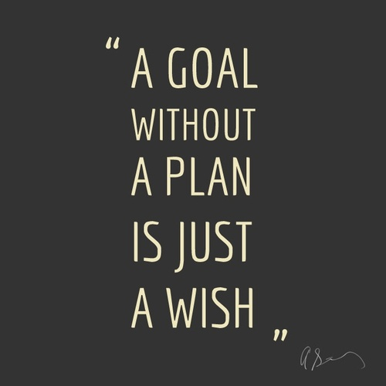

Slide 8
Levels of Learning Outcomes
Course Student Learning Outcomes (CSLOs)
Program Student Learning Outcomes (PSLOs)
Institutional Student Learning Outcomes
What do we want students to do, think, or know when they graduate with a degree from DMC?
Gen Ed/Core objectives – critical thinking, teamwork, personal responsibility, etc.
What do we want students to do, think, or know when they graduate with a degree from YOUR PROGRAM?
What do we want students to do, think, or know when they complete YOUR COURSE?
ACGM & WECM outcomes

Slide 9
SACS Core Requirement 2.7.2
How does the institution ensure that a representative sample of its degree programs demonstrates coherence in sequencing, increasing complexity, and linkages between and among program components?
Notes:
2.7.2 The institution offers degree programs that embody a coherent course of study that is compatible with its stated mission and is based upon fields of study appropriate to higher education. (Program content)
Rationale and Notes:
All programs offered by the institution are directly connected to its mission and to fields of study appropriate to higher education. In order to guide students through the continuous process of learning, the content of the program demands increasing levels of integration of knowledge. Coherence is a critical component of a program and should demonstrate an appropriate sequencing of courses, not a mere bundling of credits, so that student learning is progressively more advanced in terms of assignments and scholarship required and demonstrates progressive advancement in a field of study that allows students to integrate knowledge and grow in critical skills.
Relevant Questions for Consideration
What evidence exists that the institution offers degree programs consistent with its stated mission?
How does the institution ensure that a representative sample of its degree programs demonstrates coherence in sequencing, increasing complexity, and linkages between and among program components?
How does the institution demonstrate that its programs are appropriate to higher education?
Documentation
Required Documentation, if applicable
College/university publications listing courses required in each program offered, providing course descriptions, and course and program prerequisites
Examples of other Types of Documentation
Process for ensuring the coherence of programs and compatibility with the mission of the institution
Information regarding degree requirements, residency requirements, and other experiences as part of a program
Comparative data with similar peer institutions s Rationale for programs and their suitability for higher education
State mandates providing curriculum requirements and/or guidelines
Sample of curriculum development and approval process resulting in a program review
Reference to Commission Documents, if applicable
“Distance and Correspondence Education”
“Quality and Integrity of Undergraduate Degrees”
Cross References to other related Standards/Requirements, if applicable Federal Requirement 4.2

Slide 10
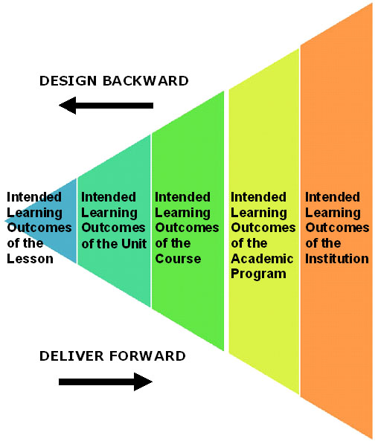
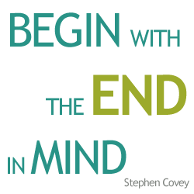
Backwards Design

Slide 11
HOW TO BUILD A CURRICULUM MAP
Faculty members begin with
a) the PSLOs
b) recommended and required courses (including Gen Ed if appropriate)
c) other required events/experiences (e.g., internships, national licensure exams)
Use the curriculum map to identify the learning opportunities (e.g., assignments, activities) that produce the program's outcomes.
Create the "map" in the form of a table
Mark the courses and events/experiences that currently address those outcomes: I, R, M, A
Faculty analyze the curriculum map.
University of Hawaii-Manoa (2013). Assessment How-to: Curriculum Mapping / Curriculum Matrix. LINK
Notes:
They discuss and revise so that each outcome is introduced, reinforced/practiced, and then mastered. In addition, each outcome should have an "A" to indicate that evidence can be collected for program-level assessment.

Slide 12
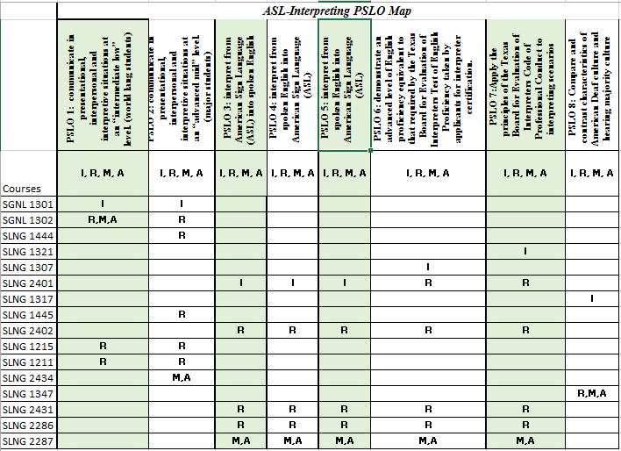

Slide 13
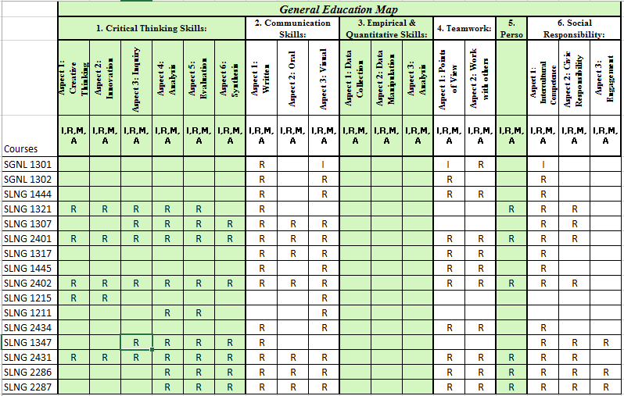

Slide 14
LEGEND - Level of Outcome Emphasis
(I) Introduced - Instruction and learning activities focus on basic knowledge, skills, and/or competencies and entry-level complexity. The course addresses only one (or a few) ⃰components of a complex program outcome.
(R) Reinforced - Instruction and learning activities concentrate on enhancing and strengthening knowledge, skills, and expanding complexity. The course addresses several components of the outcome, but these components are treated separately.
(M) Mastered - Instruction and learning activities focus on the use of content or skills in multiple levels of complexity, built upon students’ strong foundation in the knowledge, skill, or competency at the college level.
(A) Assessed - Students demonstrate their learning on the outcome through †direct methods of assessing student learning and that data is documented for program review purposes.

Slide 15
Part II
Curriculum maps in practice

Slide 16
Curriculum Map 1
Course | PLO 1 | PLO 2 | PLO 3 | PLO 4 | PLO 5
100 | I, R |  |  |  | I
101 |  | I |  |  | R
102 | R |  | R |  | R
200 | R |  | R
229 |  |  |  |  | R
230 |  |  | R, M |  | M
280
290 | M |  | R, M |  | M
Notes:
In your group, discuss:
– Is this a cohesive curriculum?
– What makes it cohesive or not?
– What recommendations, if any, would you make to this program?

Slide 17
Curriculum Map 2
Course | PLO 1 | PLO 2 | PLO 3 | PLO 4 | PLO 5 | PLO 6
100 | I
101 | R, M
102 |  | I, R, M
103 |  |  | I, R
203 |  |  | R, M
230A |  |  |  | I, R
230B |  |  |  | R, M
280 |  |  |  |  | I, R, M
290 |  |  |  |  |  | I, R, M
Notes:
In your group, discuss:
– Is this a cohesive curriculum?
– What makes it cohesive or not?
– What recommendations, if any, would you make to this program?
CURRICULUM MAP 2 - a bunch of CLOs pretending to be PLOs - isolated in silos, without synthesis

Slide 18
Curriculum Map 3
Course | PLO 1 | PLO 2 | PLO 3 | PLO 4 | PLO 5
100 | I | I | I | I | I
101 | R | R | R | R | R
102 | R | R | R | R | R
103 | R | R | R | R | R
200 | R | R | R | R | R
229 | R | R | R | R | R
230 | R | R | R | R | R
280 | R | R | R | R | R
290 | M | M | M | M | M
Notes:
In your group, discuss:
– Is this a cohesive curriculum?
– What makes it cohesive or not?
– What recommendations, if any, would you make to this program?

Slide 19
Part III
Best practices

Slide 20
Good Practices
Build in practice and multiple learning trials for students: I, R, M.
Allow faculty members to teach to their strengths (note: each person need not cover all outcomes in a single course).
Set priorities as a department/program. Everyone working together toward common outcomes can increase the likelihood that students will meet or exceed expectations.
Communicate: Publish the curriculum map and make available to all students and faculty.
Notes:
Lucy
Build in practice and multiple learning trials for students: I, R, M. Students will perform best if they are introduced to the learning outcome early in the curriculum and then given sufficient practice and reinforcement before evaluation of their level of mastery takes place.
Allow faculty members to teach to their strengths (note: each person need not cover all outcomes in a single course). "Hand off" particular outcomes to those best suited for the task.
Communicate:
If students say, “why can’t I just take this course before this one?”
Each faculty member can make explicit connections across courses for the students. For example, at the beginning of the course or unit, a faculty member can remind students what they were introduced to in another course and explain how the current course will have them practice or expand their knowledge. Do not expect students to be able to make those connections by themselves.

Slide 21
PLANNING: CURRICULUM MAPPING SESSIONS
What to bring:
1 faculty member for each course in the program.
Finalized program student learning outcomes
Syllabi and/or assignments
Course student learning outcomes (ACGM or WECM)
Notes:
Jean

Slide 22
Resources and References
University of Hawaii-Manoa (2013). Assessment How-to: Curriculum Mapping / Curriculum Matrix. LINK
Allen, M. J. (2015). Ensuring Curriculum Alignment. SACSCOC Summer Institute.
DMC Assessment of Student Learning Committee
DMC General Education Committee
DMC Canvas Assessment Handbook (coming soon!)
The Office of Assessment or Gen Ed Committee can tailor a curriculum mapping workshop for your program. Call or email jdowns2@delmar.edu to schedule.

